Slide 1

Lightning Talks
BBSW 2019

Slide 2
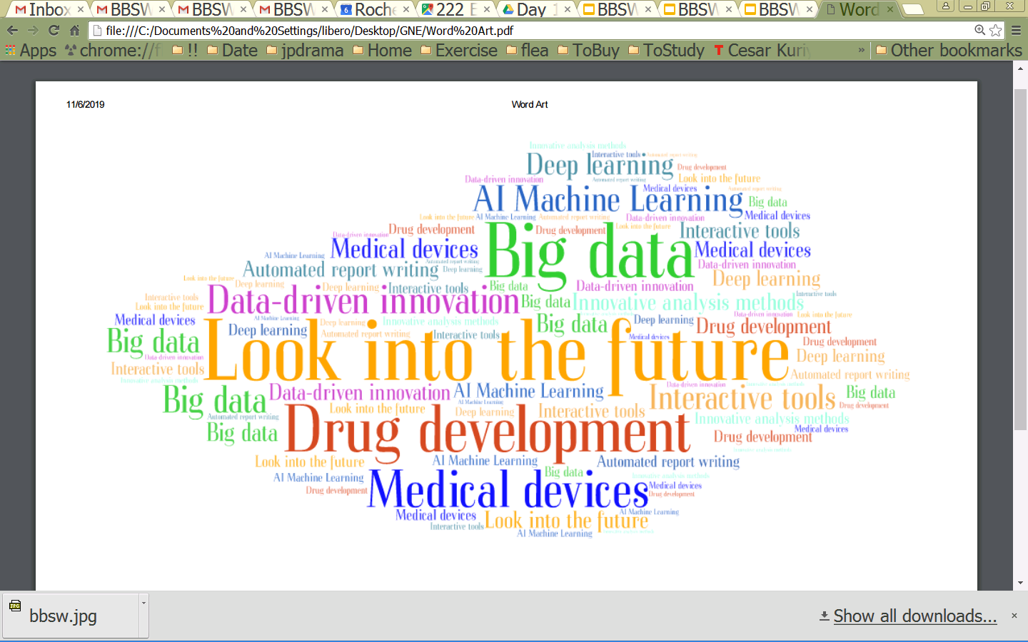
Looking into the Future

Slide 3
Road Map of the Sessions
Four talks from academia, diagnostic company, biotech/pharma, innovative health care company
...
...
Data-driven innovations
In healthcare
Computational drug discovery
Auto-assessment of clinical endpoint using deep learning
Therapeutics
Interactive analysis tools and automated report writing
Research
Pre-clinical
Phase 1-3
Regulatory approval
Post-market
Devices
Research
Feasibility
Verification
Validation
Regulatory approval
Post-market

